Slide 1
Personnel Security Overview
Kevin R. Gamache, Ph.D. I Chief Research Security Officer I The Texas A&M University System

Slide 2
What is a security clearance?
A security clearance is a personnel security determination by competent authority that an individual is eligible for access to national security information and/or assignment to duties that have been designated “national security sensitive”.
Notes:
A national security eligibility is a determination that a person is able and willing to safeguard classified national security information and/or occupy a national security sensitive position. The three national security clearance eligibility levels are: Confidential, Secret, and Top Secret.
A national security eligibility is a determination that you are eligible for access to classified information and/or eligible to hold a national security sensitive position.
Not everyone is granted a favorable eligibility determination. Only those reasonably determined not to be a national security risk are granted eligibility and permitted to handle classified information and/or hold a national security sensitive position.
The purpose of national security eligibility is to determine whether you are able and willing to safeguard classified national security information or hold a national security sensitive position, based on your loyalty, character, trustworthiness, and reliability.

Slide 3
What is classified Information
Classified information is official information or material that requires protection in the interest of national security.
Notes:
Classified information is official information or material that requires protection in the interest of national security.
Classified information is national security information, which means that it relates to the national defense and foreign relations of the United States.
If classified information is mishandled or given to the wrong person, it could harm our country’s security or that of our allies.

Slide 4
Why do we need national security eligibility determinations
To ensure that only trustworthy people have access to classified information and/or hold national security sensitive positions.
Common sense and personal experience tell us that not all people are equally trustworthy.
Notes:
The national security eligibility process is a procedure that helps make sure national security information is not given to people who cannot be trusted.

Slide 5
Special Sensitive Positions
Access to Sensitive Compartmented Information (SCI)
Positions that could cause inestimable damage to the national security and/or immeasurable compromise to technologies, plans, or procedures vital to the strategic advantage of the United States

Slide 6
What does SCI mean?
Sensitive Compartmented Information (SCI), that is, information and materials that because of their sensitivity require special controls for restricted handling within intelligence collection programs.
Special systems of information compartmentation must be formally established, with special requirements for individuals requiring “SCI access”.

Slide 7
Security Clearance Investigation Process
180 days (TS), 365+ (SCI)
60 days
Security clearance eligibility is limited to U.S. Citizens only
Notes:
A prerequisite for accessing classified national security information and/or assignment to a national security sensitive position is completion and favorable adjudication of a national security background investigation.
The investigation is non-criminal and covers a defined period of normally no more than the last 10 years. The information collected must be sufficient to allow an affirmative or negative determination of a person’s eligibility for access to classified information and/or assignment to a national security sensitive position.

Slide 8
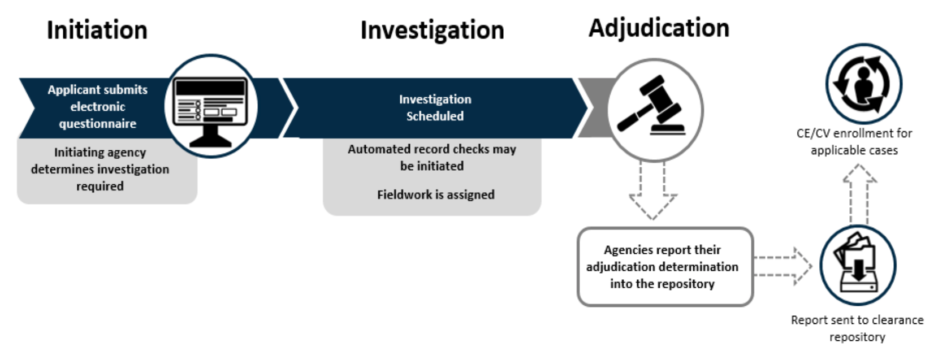
Personnel Vetting Process
Notes:
The amount of personal information you are asked to provide depends on the level of national security eligibility for which you are being nominated.
Generally, you will be required to complete the same questionnaire (SF-86) for all designated national security positions; however, the type of national security eligibility for which you are nominated will determine the depth of the investigative coverage into your background. In addition, if adverse information surfaces, a deeper investigation into your background may be required.

Slide 9
What background areas are checked?
Your employment history
Education
Reference checks
Your military service record
Foreign connections, activities, and travel
Your financial history
Your police records (if any)
Drug and alcohol abuse (if any)
Psychological conditions (if any)

Slide 10
What happens when the investigation is complete?
An adjudicator will review all of the information, both “good” and “bad” (remember, the “whole person”) and assess the information against the National Security Adjudicative Guidelines.
Outcomes:
Favorable Determination
Consideration of Mitigating Factors
Unfavorable Determination
Notes:
An adjudicator will review all of the information, both “good” and “bad” (remember, the “whole person”) and assess the information against the National Security Adjudicative Guidelines.
f there is no information that raises a security concern, the individual will usually be granted a favorable eligibility determination at the level requested by their agency.
If there is information that raises a security concern, the adjudicator will evaluate the adverse information and mitigating factors per the National Security Adjudicative Guidelines when making the eligibility determination.
If significant adverse material is identified, the case may be delayed until additional information is gathered and facts are verified. Ultimately, an unfavorable national eligibility determination may be made if the adverse information cannot be mitigated.

Slide 11
The 13 National Security Adjudicative Guidelines
Allegiance to the United States
Foreign Influence
Foreign Preference
Sexual Behavior
Personal Conduct
Financial Considerations
Alcohol Consumption
Drug Involvement and Substance Misuse
Psychological Conditions
Criminal Conduct
Handling Protected Information
Outside Activities
Use of Information Technology
Notes:
The adjudicative process is an examination of a sufficient period and a weighing of a number of variables of an individual’s life to make an affirmative determination that the individual is an acceptable security risk. This is known as the “whole person” concept.

Slide 12
How long does the eligibility process take
The completion time depends on several factors; expect the investigation to take longer if you have:
Lived or worked in several geographic locations or overseas
Traveled outside of the United States
Relatives who have lived or live outside of the United States
Background information that is difficult to obtain or involves issues that require an expansion of your case

Slide 13
Helpful tips for completing your paperwork
You must provide accurate, complete, and honest answers to all questions on your security questionnaire.
If you have any questions about what information to include in your security questionnaire, see or call the TAMUS/RSO.
Your omission of adverse information may be interpreted as falsification of your security form by an adjudicator.
Notes:
You must provide accurate, complete, and honest answers to all of the questions on your security questionnaire. Incomplete or inaccurate information can delay your eligibility determination because this information is required for processing your national security eligibility.
Providing false information is prohibited by law and punishable by fines and imprisonment. Remember, the information you provide will be verified during your investigation.
If you have any questions about what information to include in
your security questionnaire, see or call your security officer, and then answer the questions to the best of your ability. If you are in doubt as towhether you should provide certain information, it is always best practice to provide the information (and any clarification, if necessary).
Your omission of adverse information may be interpreted as falsification of your security form by an adjudicator, which may result in an unfavorable eligibility determination. Remember, when you sign your security form, you are certifying completeness and accuracy under penalty of prosecution for falsification.

Slide 14
Helpful tips for completing your paperwork

Slide 15
Polygraph Requirement

